Slide 1
Classification Metrics
a bold adventure

Slide 2
Classification models
What are we trying to do when running a classification model?
Get all the predictions right?
What’s a good metric for that?

Slide 3
Accuracy
Try to guess fruits by their weights
Have weights of 100 fruits, know there are 50 oranges and 50 apples
If we guess 36 oranges as oranges and 44 apples as apples, we necessarily guess 14 oranges as apples and 6 apples as oranges

Slide 4
Accuracy
6 wrong
14 wrong
44 right
36 right

Slide 5
Accuracy
6 wrong
14 wrong
What’s the accuracy?
44 right
36 right

Slide 6
Accuracy
6 wrong
14 wrong
What’s the accuracy?
44+36 / (44+36+6+ 14)
= 80/100 = 80%
44 right
36 right

Slide 7
Accuracy
If we got 10 apples right and 10 oranges right
40 wrong
40 wrong
What’s the accuracy?
10 right
10 right

Slide 8
Accuracy
If we got 10 apples right and 10 oranges right
40 wrong
40 wrong
What’s the accuracy?
10+10 / (10+10+40+40)
= 20/100 = 20%
10 right
10 right

Slide 9
Accuracy
No problem right? But what if we had 90 apples and 10 oranges
5 wrong
And we guessed 85 apples right, but only guessed 1 orange right
85 right
9 wrong
1 right

Slide 10
Accuracy
No problem right? But what if we had 90 apples and 10 oranges
5 wrong
And we guessed 85 apples right, but only guessed 1 orange right
What’s the accuracy?
85 right
9 wrong
1 right

Slide 11
Accuracy
No problem right? But what if we had 90 apples and 10 oranges
5 wrong
And we guessed 85 apples right, but only guessed 1 orange right
What’s the accuracy?
85+1 / (85+1+15+9)
= 86/100 = 86%
85 right
9 wrong
1 right

Slide 12
Accuracy
What are some problems with using accuracy ?
5 wrong
What’s the accuracy?
85+1 / (85+1+15+9)
= 86/100 = 86%
85 right
9 wrong
1 right

Slide 13
Accuracy
• If we just guessed ‘apple’ each time, we would have a higher accuracy than if we tried to guess based on data (the ‘naive classifier’ is better than our model)
What are some problems with using accuracy ?
5 wrong
What’s the accuracy?
85+1 / (85+1+15+9)
= 86/100 = 86%
85 right
9 wrong
1 right

Slide 14
Accuracy
• If we just guessed ‘apple’ each time, we would have a higher accuracy than if we tried to guess based on data (the ‘naive classifier’ is better than our model)
What are some problems with using accuracy ?
5 wrong
• Accuracy, as a metric, doesn’t capture what’s going on in each of our classes
What’s the accuracy?
85+1 / (85+1+15+9)
= 86/100 = 86%
85 right
9 wrong
1 right

Slide 15
More Refined Metrics

Slide 16
More Refined Metrics
NEW EXAMPLE
the question we’re investigating: ‘Is this a unicorn’?
And for each observation (each animal), our model is going to predict ‘positive’ (ie yes this is a unicorn) or ‘negative’ (ie no this is not a unicorn)

Slide 17
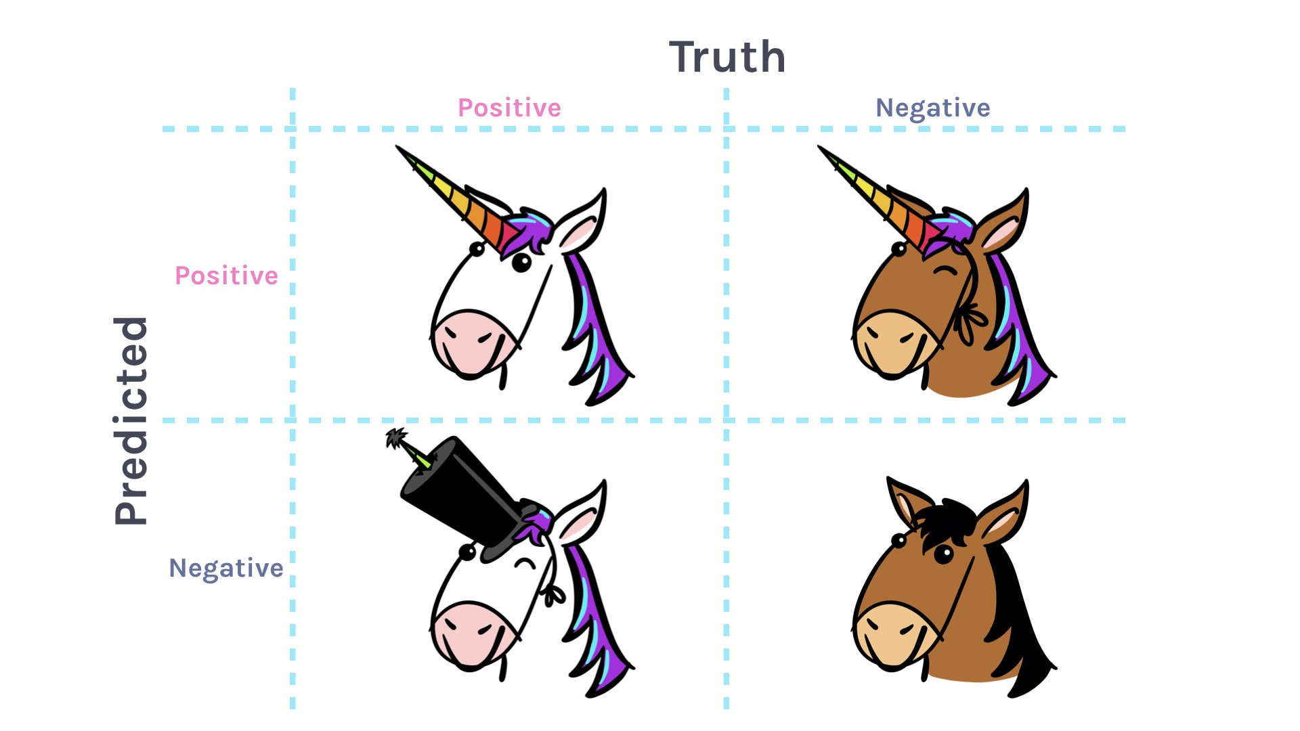
More Refined Metrics - vocab
Negative
Positive
Labeled ‘0’ in target data
Labeled ‘1’ in target data

Slide 18
More Refined Metrics - vocab
Predict
‘Is this a unicorn?’
Truth
Negative
Negative
True Negative
Model predicts ‘0’ for target value
Labeled ‘0’ in target data

Slide 19
More Refined Metrics - vocab
Predict
‘Is this a unicorn?’
Truth
Positive
Positive
True Positive
Model predicts ‘1’ for target value
Labeled ‘1’ in target data

Slide 20
More Refined Metrics - vocab
Predict
‘Is this a unicorn?’
Truth
Positive
Negative
False Positive
Model predicts ‘1’ for target value
Labeled ‘0’ in target data

Slide 21
More Refined Metrics - vocab
Predict
‘Is this a unicorn?’
Truth
Positive
Negative
False Positive
Model predicts ‘1’ for target value
Labeled ‘0’ in target data

Slide 22
More Refined Metrics - vocab
Predict
‘Is this a unicorn?’
Truth
Negative
Positive
False Negative
Model predicts ‘0’ for target value
Labeled ‘1’ in target data

Slide 23
More Refined Metrics - vocab
Predict
‘Is this a unicorn?’
Truth
Negative
Positive
False Negative
Model predicts ‘0’ for target value
Labeled ‘1’ in target data

Slide 24
CONFUSION
MATRIX

Slide 25
More Refined Metrics

Slide 26
More Refined Metrics
TRUE POSITIVES

Slide 27
More Refined Metrics
TRUE POSITIVES
TRUE NEGATIVES

Slide 28
More Refined Metrics
TRUE POSITIVES
FALSE POSITIVES
TRUE NEGATIVES

Slide 29
More Refined Metrics
TRUE POSITIVES
FALSE POSITIVES
FALSE NEGATIVES
TRUE NEGATIVES

Slide 30
More Refined Metrics

Slide 31
More Refined Metrics
37
1
20
42

Slide 32
More Refined Metrics
Overall accuracy = 79 / 100
37
1
20
42

Slide 33
More Refined Metrics
37/57 of the unicorns were classified as unicorns
37
1
20
42

Slide 34
More Refined Metrics
42/43 of the horses were classified as horses
37
1
20
42

Slide 35
More Refined Metrics
37/38 of the animals predicted as unicorns were unicorns
37
1
20
42

Slide 36
More Refined Metrics
42/62 of the animals predicted as horses were horses
37
1
20
42

Slide 37
More Refined Metrics - calcs
PRECISION
Out of the positives I predicted, how many did I get correct?

Slide 38
More Refined Metrics - calcs
PRECISION
Out of the positives I predicted, how many did I get correct?

Slide 39
More Refined Metrics - calcs
PRECISION
Out of the positives I predicted, how many did I get correct?
TRUE POSITIVES

Slide 40
More Refined Metrics - calcs
PRECISION
Out of the positives I predicted, how many did I get correct?
TRUE POSITIVES
TRUE POSITIVES

Slide 41
More Refined Metrics - calcs
PRECISION
Out of the positives I predicted, how many did I get correct?
TRUE POSITIVES
TRUE POSITIVES
TRUE POSITIVES
FALSE POSITIVES

Slide 42
More Refined Metrics
37
1
20
42

Slide 43
More Refined Metrics - calcs
PRECISION
Out of the positives I predicted, how many did I get correct?
TRUE POSITIVES
TRUE POSITIVES
TRUE POSITIVES
FALSE POSITIVES

Slide 44
More Refined Metrics - calcs
PRECISION
Out of the positives I predicted, how many did I get correct?
37
37
1

Slide 45
More Refined Metrics - calcs
RECALL
Out of the positives that exist in the real world, how many did I get right?

Slide 46
More Refined Metrics - calcs
RECALL
Out of the positives that exist in the real world, how many did I get right?
TRUE POSITIVES
TRUE POSITIVES

Slide 47
More Refined Metrics - calcs
RECALL
Out of the positives that exist in the real world, how many did I get right?
TRUE POSITIVES
TRUE POSITIVES
TRUE POSITIVES

Slide 48
More Refined Metrics - calcs
RECALL
Out of the positives that exist in the real world, how many did I get right?
TRUE POSITIVES
TRUE POSITIVES
TRUE POSITIVES
FALSE NEGATIVES

Slide 49
More Refined Metrics
37
1
20
42

Slide 50
More Refined Metrics - calcs
RECALL
Out of the positives that exist in the real world, how many did I get right?
TRUE POSITIVES
37
37
20

Slide 51
More Refined Metrics - calcs
Why do these matter?
More “accurate” than accuracy: better picture of what’s going on
The context in which the analysis is done - the ‘question’ you’re investigating - might mean focusing on one than another

Slide 52
More Refined Metrics - calcs
Context examples
Fraud: ‘how many instances of fraud does my model find’ vs ‘how many customers will I piss off if I falsely accuse them of fraud’

Slide 53
More Refined Metrics - calcs
Context examples
Disease: ‘out of all the people who have a positive test, how many have the disease?’ vs ‘how many people with the disease can the test identify’?

Slide 54
More Refined Metrics - calcs
What if I want to optimize for both at the same time?
F1 Score: harmonic mean of precision and recall (penalizes wrong guesses)
2*precision*recall
0 (worst) to 1 (best)
(precision + recall)

Slide 55
More Refined Metrics - calcs
What if I want to optimize for both at the same time?
AUC-ROC score: the ‘area under the curve’ of the ‘receiver operating characteristics’ curve
idea comes from information theory, developed during dubya-dubya two

Slide 56
More Refined Metrics - calcs
What if I want to optimize for both at the same time?
1
The ‘true positive rate’ and ‘false positive rate’ form a trade-off, which can be graphed
True Positive Rate
0
1
False Positive Rate

Slide 57
More Refined Metrics - calcs
What if I want to optimize for both at the same time?
1
That graph is the ROC curve; the area under the ROC curve is the AUC-ROC score and the metric for the model
True Positive Rate
0
1
False Positive Rate

Slide 58
More Refined Metrics - calcs
What if I want to optimize for both at the same time?
1
The AUC-ROC score is essentially “how much is the model capable of distinguishing among different classes?”
True Positive Rate
0
1
False Positive Rate

Slide 59
More Refined Metrics - calcs
What if I want to optimize for both at the same time?
1
Perfect model is 1, ‘every prediction is wrong’ model is 0, dashed-line = model 50% right = .5
True Positive Rate
0
1
False Positive Rate

Slide 60
More Refined Metrics - calcs
What if I want to optimize for both at the same time?
1
Perfect model is 1, ‘every prediction is wrong’ model is 0, dashed-line = coin-flip for each prediction = .5
True Positive Rate
0
1
False Positive Rate

Slide 61
More Refined Metrics - calcs
What if I want to optimize for both at the same time?
1
Perfect model is 1, ‘every prediction is wrong’ model is 0, dashed-line = coin-flip for each prediction = .5
True Positive Rate
0
1
False Positive Rate

Slide 62
Back to comparing apples and oranges
5 wrong
85 right
9 wrong
1 right

Slide 63
Back to comparing apples and oranges
Truth
0
1
5 wrong
0
85
9
Predicted
85 right
1
5
1
9 wrong
1 right
‘0’
‘1’

Slide 64
Back to comparing apples and oranges
Truth
Precision = 1/6
0
1
5 wrong
Recall = 1/10
0
85
9
Predicted
85 right
1
5
1
9 wrong
1 right
‘0’
‘1’

Slide 65
Back to comparing apples and oranges
Truth
F1 = 2*(.1)*(.03)
0
1
5 wrong
0
85
9
(.1+.03)
=.05
Predicted
85 right
1
5
1
9 wrong
1 right
‘0’
‘1’

Slide 66
Improving model besides metric selection
‘0’
‘1’

Slide 67
Improving model besides metric selection
Upsampling
‘0’
‘1’

Slide 68
Improving model besides metric selection
Upsampling
Randomly sample from the smaller ‘minority’ class
‘0’
‘1’

Slide 69
Improving model besides metric selection
Upsampling
Randomly sample from the smaller ‘minority’ class
‘0’
‘1’

Slide 70
Improving model besides metric selection
Downsampling
‘0’
‘1’

Slide 71
Improving model besides metric selection
Downsampling
Randomly remove data from the larger ‘majority’ class
‘0’
‘1’

Slide 72
Improving model besides metric selection
Downsampling
Randomly remove data from the larger ‘majority’ class
‘0’
‘1’

Slide 73
Improving model besides metric selection
Synthetically create new minority class data
Popular: ‘SMOTE’ Synthetic Minority Oversampling Technique
‘0’
‘1’

Slide 74
Improving model besides metric selection
Where in the workflow do we over/under/synthetically sample?

Slide 75
Improving model besides metric selection
Where in the workflow do we over/under/synthetically sample?
After train-test split

Slide 76
Improving model besides metric selection
Where in the workflow do we over/under/synthetically sample?
After train-test split
If before, then information will ‘leak’ from test to train set

Slide 77
Improving model besides metric selection
Where in the workflow do we over/under/synthetically sample?
After train-test split
If before, then information will ‘leak’ from test to train set
Test metrics won’t reflect seeing ‘new’ data

